Slide 1
Applying Results-Based Accountability™ to Connecticut Juvenile Justice Programs
Presented by:
Ron Schack, Ph.D.
Director
The Charter Oak Group, LLC
June 28, 2011

Slide 2
What are we talking about today?
What is RBA?
RBA at the Connecticut General Assembly
RBA applied to Juvenile Justice Policy and Operations Coordinating Committee
RBA applied to Joint Juvenile Justice Strategic Plan
RBA in individual agencies and related efforts

Slide 3
What is Results-Based Accountability™ (RBA)?
RBA is a public accountability framework developed by Mark Friedman of the Fiscal Policy Studies Institute that:
Identifies the quality of life results that the we are collectively trying to achieve for the residents of the state
Links strategies (as expressed by programs, agency activities, statutes, policies, regulations, etc) to these quality of life results
Provides an approach to measuring programs along three key dimensions:
  How much activity or service is provided
  How well the program or service is operated/managed
  Whether anyone is better off as result of the activity, service, or program
Allows for the introduction of this information on programs into the budget decision process
Fosters dialog between legislators and agencies staff
Identifies current and potential partnerships in contributing to these quality of life results

Slide 4
What RBA Is NOT:
RBA is NOT a substitute for formal program evaluation, although an RBA framework can provide a foundation for evaluation activities (and building an evidence-base) and evaluation results can inform RBA
RBA is NOT biased toward budget accretion or budget reduction
RBA is NOT a replacement for other inputs into the budget process: availability of resources, politics, need, etc.

Slide 5
What Makes RBA Different?
Many aspects of RBA build on a long tradition of evaluation and performance measurement work. However, RBA makes some important distinctions:
  Emphasis on Quality of Life Results. RBA emphasizes determining the extent to which we, collectively (residents, state agencies, municipalities, non-profit organizations, foundations, business, etc.) are achieving the quality of life results (ends) we are trying to achieve. We make that determination without regard to the particular means (programs and services) we are currently using in attempting to achieve those ends.
  Use of Indicators. Indicators are measures that show the extent to which we collectively are achieving particular quality of life results.

Slide 6
What Makes RBA Different, Continued
Population vs. Performance Accountability. Population accountability is about the well being of whole populations, like all residents of the state of CT. Performance accountability is about the well-being of client populations, like all those served by a particular program. It is confusion about these kinds of accountability that has hampered progress on a common sense and useful approach to public accountability.
Emphasis on Whether Anyone Is Better Off. Government agencies, in particular are used to counting things and reporting the scale and scope of their activities. While RBA allows for this, it demands that programs also provide information on whether recipients of services are better off as a result of those services.
Emphasis on the Role of Partners.
Emphasis on Low-cost/No-cost and Doing The Least Harm.

Slide 7
RBA at the Connecticut Legislature
In a multi year, multi-stage pilot, RBA has been used by the Appropriations committee in the budget process for the past 6 years
This year, 43 agencies were asked to develop a report card for program selected by the relevant sub-committee of Appropriations. The programs were, generally, selected because they had a substantial impact on the budget, or were one of the agency’s largest or high-profile programs. These programs were the focus of the forums held in December of 2010. In addition, agencies that had prepared report cards for programs in 2009 were asked to refresh these report cards with the most recent data available, and make any other changes that were appropriate.
This year we moved from pilot to full implementation. That means that beyond the report cards mentioned above, RBA questions served as the foundation of the budget hearings.
Check out: http://www.cga.ct.gov/app/rba/

Slide 8
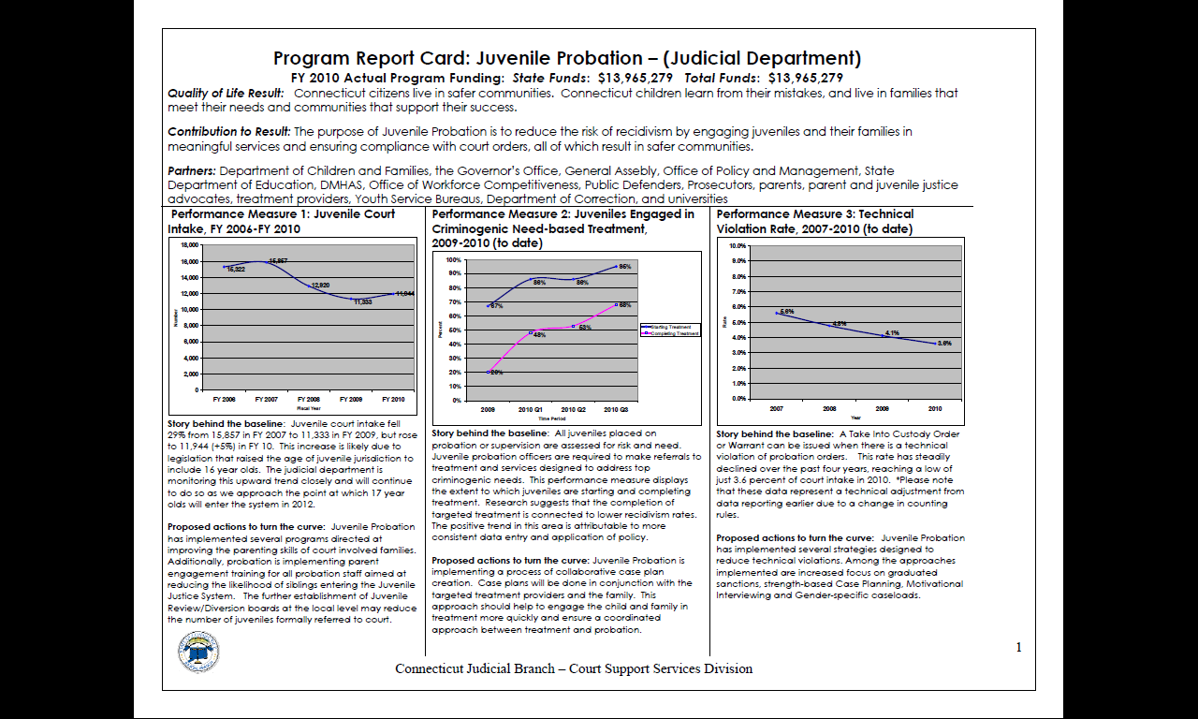

Slide 9
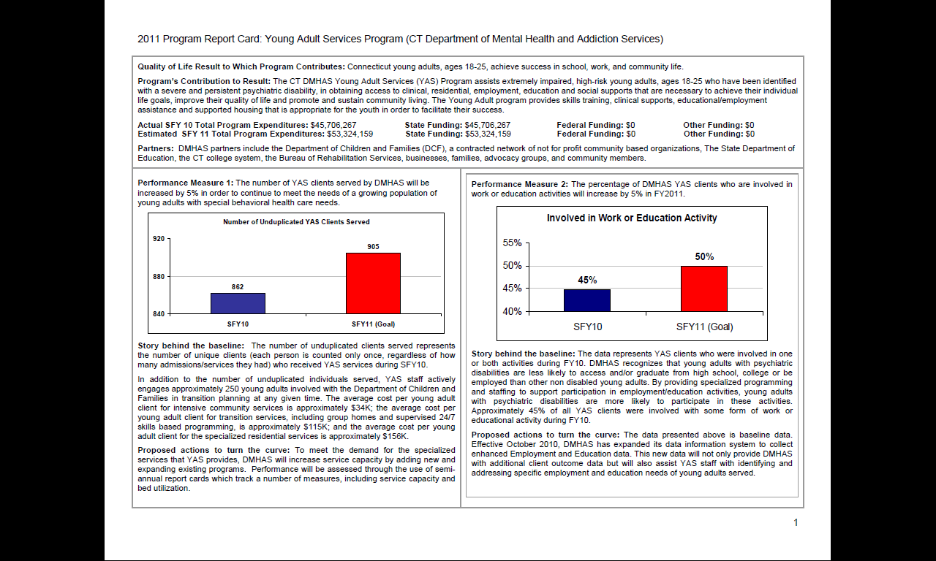

Slide 10
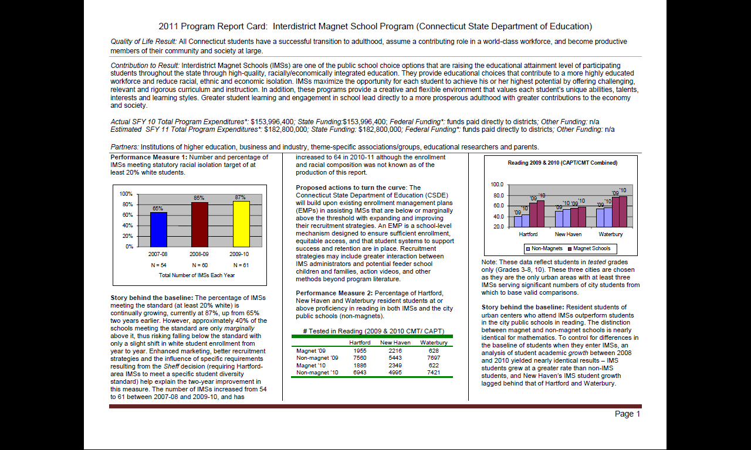

Slide 11
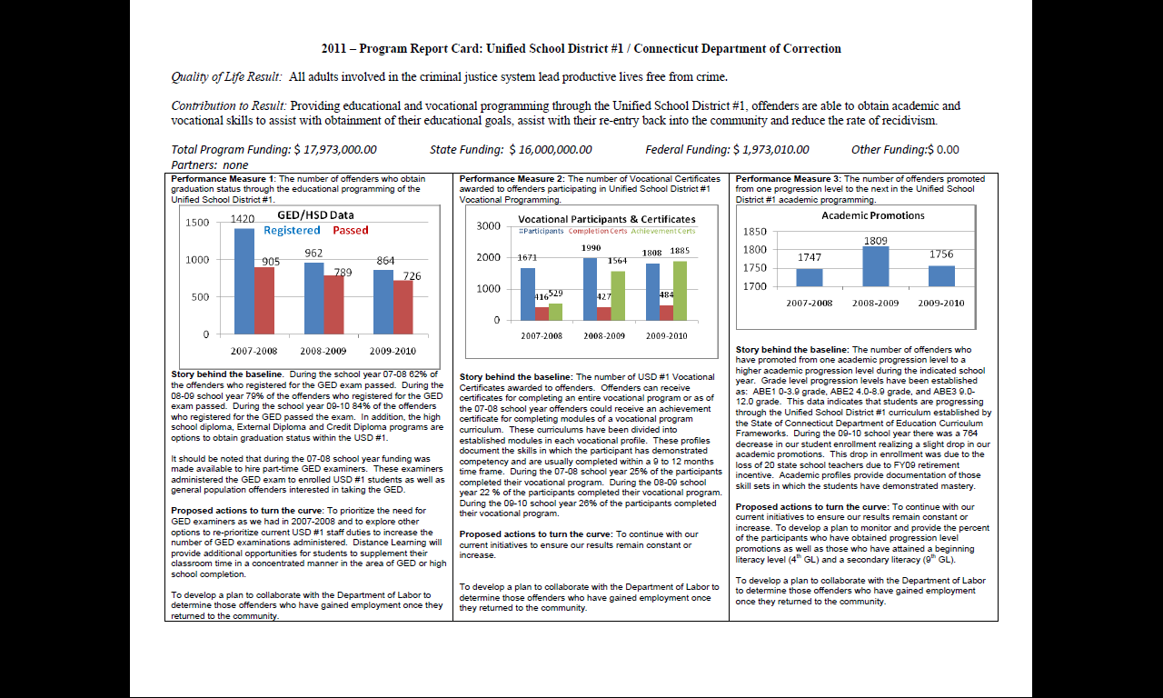

Slide 12
Raise The Age: Juvenile Justice Policy and Operations Coordinating Council
Uses RBA framework
  Results
  Indicators
  Strategies
  System Performance Measures
  Common Program Performance Measures
  Aligned with RBA framework from Joint Juvenile Justice Strategic Plan

Slide 13
JJPOCC Quality of Life Results
The foundation of the JJPOCC RBA model are two state/community level quality of life results:
All CT children at risk of justice involvement or justice involved will realize their full potential and live safe and independent lives.
All state residents are safe and have a fair and responsive juvenile justice system

Slide 16
Joint Juvenile Justice Strategic Plan
Uses RBA framework
  Result
  Indicators
  Strategies
  Performance Measures
  Informed by JJAC system flow data
  Local Interagency Service Teams aligned with RBA framework

Slide 17
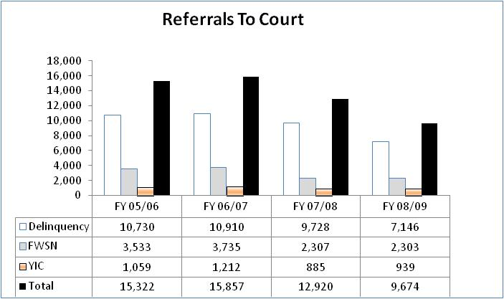
Sample Indicator

Slide 18
Local Interagency Service Teams
Trained in use of RBA as planning framework
Provided local and court catchment-area data for use in planning process (Dr. Josephine Hawke).

Slide 19
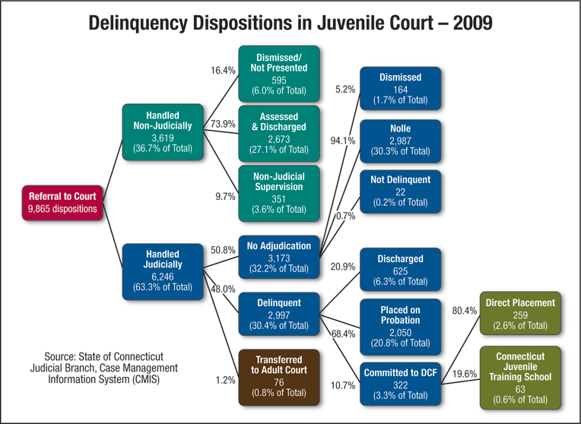
JJAC System Flow Data

Slide 20


Slide 21
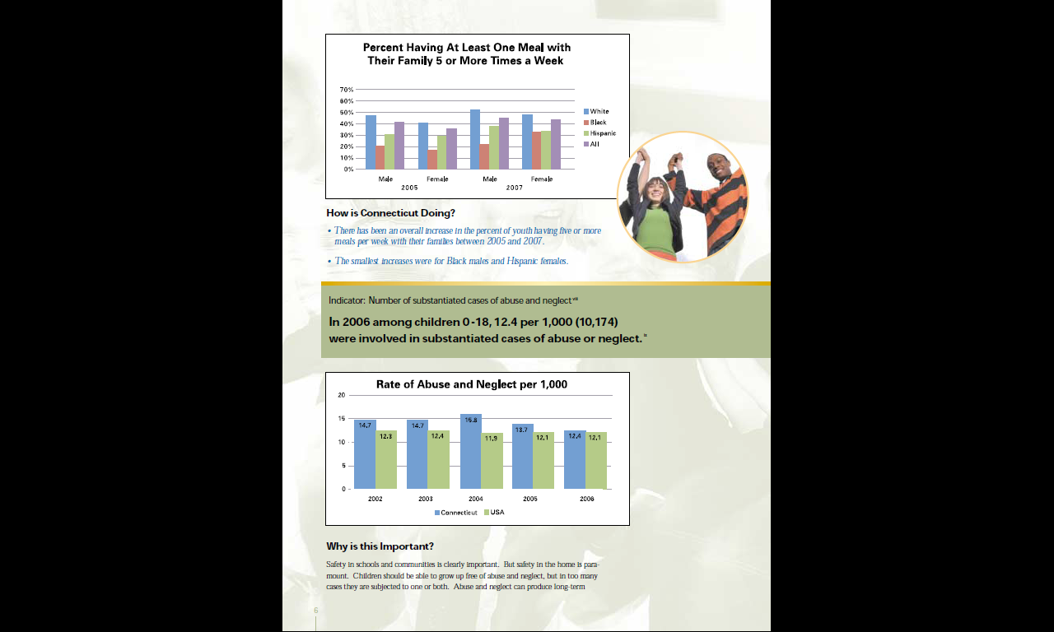
Related Efforts
Connecticut Data Partnership
Association of Evidence-Based and Promising Practices
JJAC System Flow Data

Slide 22
Where do evidence-based practices fit?
Evidence-based practices fit into the RBA approach in many ways:
  Service delivery models with a strong evidence base should be identified when answering the “what works to do better” question at both the population and performance accountability level
  During the early phases of implementing an evidence-based practice, when better off measures (outcomes) for clients may not have ripened, it is appropriate to use the existing evidence –base from other jurisdictions as a starting point During early implementation, use of many “how well” measures, particularly those associated with monitoring how closely implementation is faithful to the original evidence based model, are very important
  However, it is important not to stop with the above approach. Eventually it is important to determine whether the services you are providing are working for your clients, whatever the evidence base says. This leads to a number of considerations:

Slide 23
Considerations
It is critical to remember that evidence-based models are not generic; generally, evidence-based models have been established for:
    Particular client groups
    In particular environments
    Using a specific service approach and DOSAGE;
One of the on-going issues with evidence-based practices is the “loosely held” evidence-based practice…when a practice begins to gain traction, everyone “says” they are doing it, observing some of the forms, but ignoring some of the above considerations.
It is critical that “how well” measures are used to ensure fidelity to model; if the customer group or environment differs from that of the original evidence-based model, it is important to determine whether your approach is working for your clients. Doing so also ADDS TO THE EVIDENCE BASE for the model.

Slide 24
Where do we go from here?
Greater use of RBA at program level
Greater use of RBA at system level
Greater use of RBA for performance contracting
Use of RBA to create the foundation for common / pooled evaluation efforts

Slide 25
Thank You
For more information contact:
Ron Schack, Ph.D.
The Charter Oak Group, LLC
860-478-7847
rschack@charteroakgroup.com
www.charteroakgroup.com

